Slide 1

Credit Card Approval Prediction
CS3244 Group 17
Presentation order: Liu Ziyu, Megan Meredith Law, Felicia Mah, Lim Si Jing, Shereen Tan

Slide 2




Table of contents
1
Background
2
Data Collection &
Feature Engineering
3
Model Building
4
Evaluation
Motivation & Objective
Removal of unnecessary data
Conclusion for the different models and suggestions for improvements
Different Models for training and testing

Slide 3

1
Background
Motivation & Objective

Slide 4
Predict if a customer is not risky or risky to be issued a credit card given the relevant features.
Problem Statement

Slide 5
Motivation
Find out the characteristics of candidates who possess the right criterias to be determined as a not risky customer.
Implementing models that can predict the right results most of the time.

Slide 6



Objective
Target
Prediction
Explanation
Using past credit repay record column ‘STATUS’ to generate a new ‘TARGET’ column
Build machine learning models to predict if a customer is risky or not risky
Best model chosen to predict the dataset

Slide 7
2
Data Collection & Feature Engineering
Data Cleaning and Feature Engineering

Slide 8


Datasets
Application
Credit
Consists of different columns with client information by ID
Credit record that an applicant has with the bank (the amount of time they took to repay the loan for a particular month)

Slide 9
Data cleaning
1
2
3
Checked for NA values, removed rows with duplicated application
Changed all data to categorical or numeric
Using ‘Status’ column to generate ‘Target’ column, then split data

Slide 10
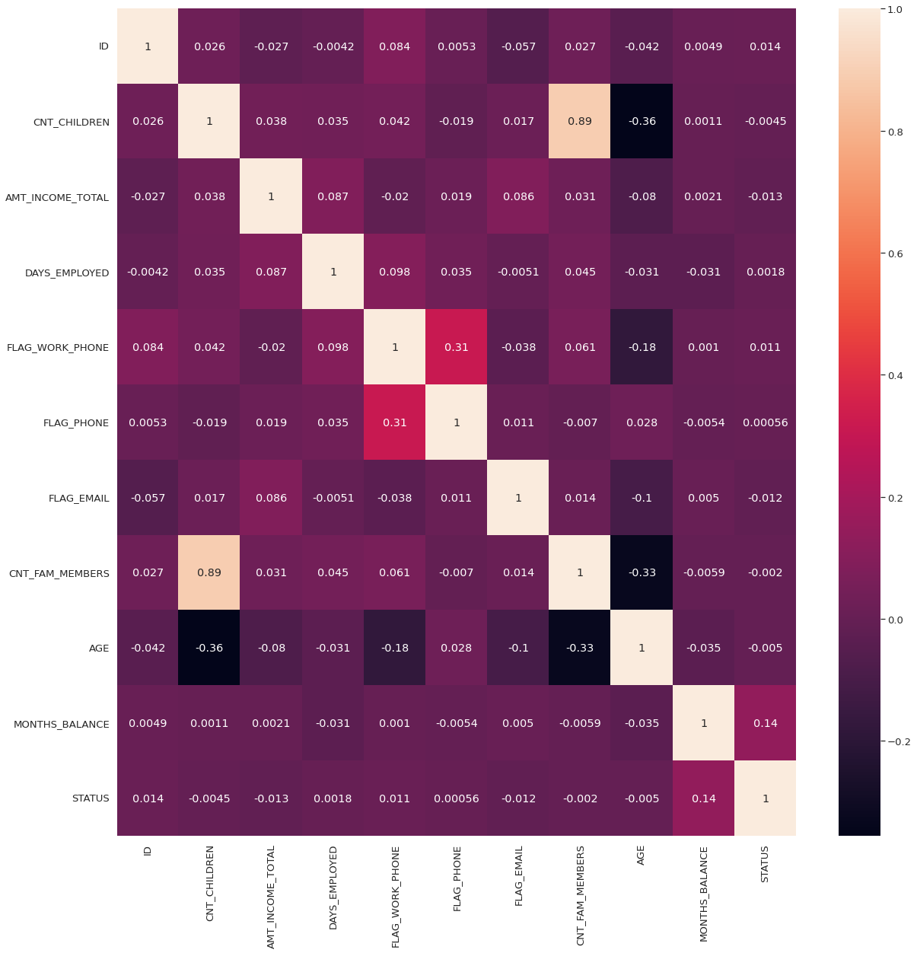
Feature Engineering
Plotted various correlation heatmaps to find out the correlation between the categories in each column. Group those categories which are highly correlated and create dummy variables for all the categories
Notes:
We applied feature engineering…… expanding our data into all 0 or 1s. The heatmap on the right shows the correlation heatmap of non category columns (next slide)

Slide 11
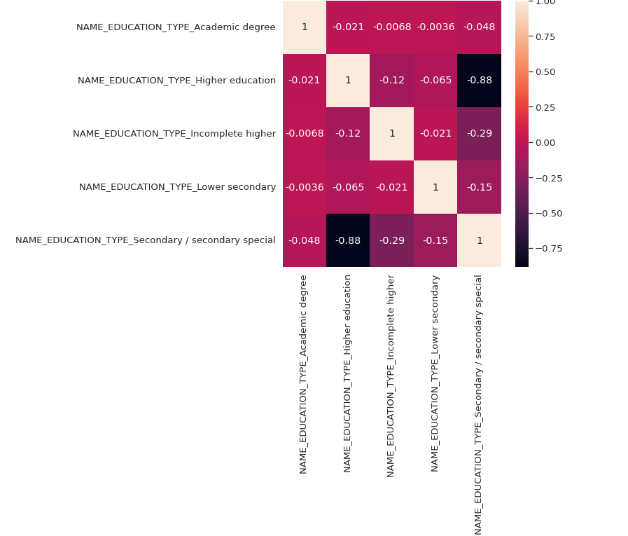
Feature Engineering
Correlation for ‘NAME_EDUCATION_TYPE’ column
Notes:
The next diagram shows the heatmap of the correlation for name education type column…… And the same goes for all other columns, where we plot the heatmap on each column. (next)

Slide 12

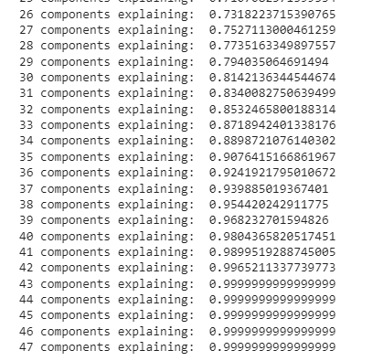

Data standardization using StandardScaler
Dimension reduction using PCA
We set 1 (risky customers) to be positive, and we want to minimize FN

Slide 13
3
Model Building
Different Models for Training and Testing
Notes:
Moving on to the building of the models, our group decided to make use of 4 models — logistic regression, support vector machine, decision tree, and random forest.

Slide 14
Model 1 : Logistic Regression
How it works:
Rationale:
Computes a sum of the input features and calculates the logistic of the result
Values closer to 1 → classified as Risky
Values closer to 0 → classified as Not Risky
Easy to implement
Easy to interpret
Very efficient to train for binary classification problems
Less likely to overfit data
Notes:
The first model we used was the logistic regression model which can be used to predict the probability of an applicant being a risky or non-risky client . We chose this as our baseline model as it is easy to implement, interpret, and very efficient to train for binary classification problems. It is also less likely to overfit the data.
So how it works is that it computes a sum of the input features and calculates the logistic of the result. The closer the value is to 1, the higher the probability the current applicant is classified as risky. The closer the value is to 0, the higher the probability the applicant will be classified as not risky.

Slide 15
Results
Actual Label
Risky | Not Risky
Accuracy | 0.61
Precision | 0.0056
Recall | 0.61
F1 Score | 0.011
509 | 89688
332 | 142786
Risky
Predicted Label
Not Risky
Notes:
After running the model on our balanced X & Y training data and comparing the predicted & actual Y values, we achieved an accuracy of around 0.61, precision of 0.0056, recall of 0.61, and f1 score of 0.011.
These values can also be verified by manual calculation using the confusion matrix on the right.

Slide 16
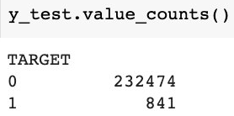
Analysis of Results
Low Accuracy → data is not linearly separable
Low Precision → high number of false positive cases
Low Recall → high number of false negative cases
Notes:
The low accuracy of 0.61 suggests that the data is not linearly separable and that the target label has no linear correlation with the features. Hence we later explore other models as well which can better handle data that is non-linearly separable.
We also have a low precision value of 0.0056. This is due to the imbalanced data where there is significantly more non-risky applicants than risky applicants as shown on the right. Because of this, all the models will display a disproportionately lower precision value and hence a lower f1 score which is affected by a model’s precision. This low precision value suggests a high number of false positive cases where non-risky applicants are wrongly classified as risky. This may be of slight concern as banks would not issue credit cards to these applicants, causing them to lose business.
The model also returned a low recall value of 0.61 which suggests a high number of false negative cases as well. This is of a higher concern than the false positive cases as more false negative cases suggest a higher number of risky applicants being wrongly classified as not risky. Banks would then issue credit cards to these risky applicants and end up losing a lot of money when they do not repay their loan on time.
We also have a low F1 score which is to be expected due to the poor precision and recall.
Since the accuracy, precision, recall & f1 score are all less than 70%, we decided to explore other models which may be better suited for our data and provide us with better results. I will now pass on the time to felicia who will further elaborate on our next model — the support vector machine.

Slide 17
Model 2 : Support Vector Machine
Choice of kernel would depend on how linearly separable our data would become after transformation
4 possible kernels:
Linear
Polynomial
Radial Basis Function
Sigmoid
Notes:
We are using the decision tree as our baseline model.

Slide 18
Choice of kernels & Limitation
To get the best choice of kernels, we decided to perform k-fold cross validation to obtain the kernel that would best linearly separate our data
However, due to imbalanced data, doing cross-validation on our model falsely gave us high accuracy result close to 100% for each of the models.
Example snapshot of code:

Slide 19
Solution - Manual balancing of data
As a solution, we employed manual iteration for cross validation in order to be able to balance our training set before testing on the validation set.
Another advantage of this solution is that we were able to choose the type of cross validation that would best suit our model.
We used “Repeated Stratified K Fold” in order to produce more reliable results through repetition and also similar ratio of representation of both classes in each of the sets.

Slide 20
Results
Repeated Stratified K Fold - repeats = 2, number of folds = 4
Choice of Kernels | Accuracy | Standard Deviation
Linear | 0.57 | 0.021
Polynomial | 0.84 | 0.021
Radial Basis Function (RBF) | 0.71 | 0.017
Sigmoid | 0.50 | 0.024

Slide 21
Evaluation: Best performing kernel
Best performing kernel on cross validation set
Kernel | Accuracy | Standard deviation
Polynomial | 0.84 | 0.021

Slide 22
Evaluation: Analysis of different kernels
The “Polynomial” kernel yielded the highest accuracy and relatively low standard deviation, meaning that this kernel was the most reliable and also best in performance.
“Linear” kernel performed badly at 0.57 accuracy since our data is likely to not be linearly separable since we have many data points in a comparably small dimensional space.
On the other hand, “Sigmoid” and “Radial basis functions” might have overfit our model since a simple polynomial function of degree 3 was sufficient to map our data points into a linearly separable space.

Slide 23
Final results
Results on actual testing set:
Kernel | Accuracy
Polynomial | 0.81
Analysis:
Accuracy at 0.81, significantly above the benchmark of 0.5, which would be the accuracy for random guessing.
“Polynomial” kernel does not take as much time to train as other kernels such as “RBF”kernel.
Precision | 0.010
Recall | 0.54
F1 Score | 0.020

Slide 24
Model 3 : Decision Tree
Actual Label
Risky | Not Risky
Picks the feature that best divides the space into different labels
Flowchart structure
748 | 44808
93 | 187666
Risky
Predicted Label
Not Risky

Slide 25
Results: Decision tree
Accuracy | 0.81
Precision | 0.016
Recall | 0.89
F1 Score | 0.032
Accuracy of decision tree is 0.81
Although the decision tree gave good results based on performance metrics, we seek to improve the decision tree model and hence, we move on to evaluate the random forest model.

Slide 26
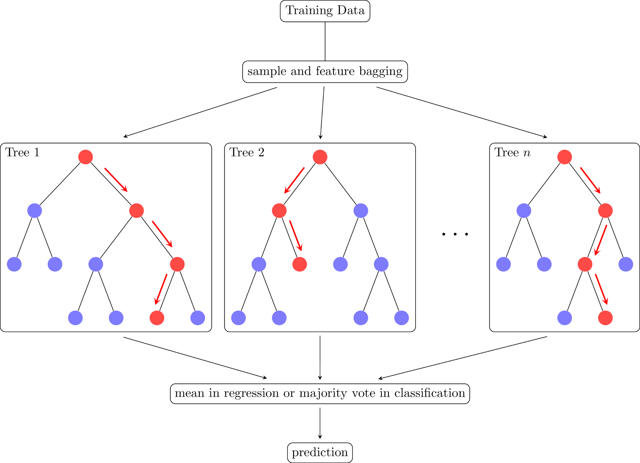
Model 4 : Random Forest
Reliable ensemble of multiple decision tree
Lower variance compared to decision tree

Slide 27
Results: Random forest
Actual Label
Risky | Not Risky
Accuracy of 0.94
Precision of 0.052
Recall of 0.92
F1 score of 0.098
Accuracy and recall are higher than the ones for decision tree
776 | 14168
65 | 218306
Risky
Predicted Label
Not Risky

Slide 28
4
Interpreting the results
Explanation of model performance
Future improvement
Notes:
I will interpret that results of the different models we applied and talk about some future improvements our group would like to have

Slide 29
Explanation on model performance :
Logistic Regression
Accuracy | 0.61
Precision | 0.0056
Recall | 0.61
F1 score | 0.011
Poor performance with recall 0.61
Justification:
Collinearity and outliers affect the scores of the model
Linearity assumption between independent variables and dependent variable
Linear boundaries
Notes:
Firstly, the performance of the logistic regression model is poor with a low recall score of 0.61. We will be using this model as our baseline model. Looking into the possible reasons for such Low recall score, we have concluded that the main cause is the linear assumption between independent variables and dependent variables. The decision boundary drawn in a logistic regression model is linear but our dataset is not linearly separable. Another reason is that collinear relationships and outliers which affects model performance are not being considered and adjusted for.

Slide 30
Explanation on model performance :
Support Vector Machine (SVM)
Accuracy | 0.81
Precision | 0.010
Recall | 0.54
F1 score | 0.020
Kernel = poly
Poor performance with recall 0.54
Justification:
Test dataset is unbalanced, hyperplane is skewed to the minority class
Noise in the dataset
Notes:
Knowing that our dataset size is not large and is not linearly separate we applied the Support Vector Machines (SVM). Using the kernel function in SVM, we can transform linearly inseparable data to become linearly separable. Trying out the different kernels, we have concluded that poly gives the best performance. Here, we also see a poor recall score of 0.54. The main reason for this is that the test dataset is imbalanced and the hyperplane is skewed towards the minority class. It could also be that there is still noise in the dataset and we have to do more cleaning

Slide 31
Explanation on model performance :
Decision Tree
Accuracy | 0.81
Precision | 0.016
Recall | 0.89
F1 score | 0.032
Good performance with high recall 0.89
Huge improvement from Logistic Regression model
Justification:
Able to handle both categorical and continuous variables
Decision Tree is more flexible in drawing decision boundaries
Non-essential features are excluded or ignored
Handle collinearity better than Logistic Regression
Notes:
Wanting to further improve the recall score, our team explored the decision tree. The decision tree was tested because it can handle both categorical and continuous variables which was our data set. With the greater flexibility in drawing decision boundaries, and the ability to exclude non essential features, we saw a significant increase in recall score.The increase in performance is also because the model can handle collinear relationships between variables better

Slide 32
Explanation on model performance :
Random Forest
Accuracy | 0.94
Precision | 0.052
Recall | 0.92
F1 score | 0.098
Best performing model with highest recall 0.92271
Justification:
Since Random Forest considers the outcomes from many different Decision Trees, it has a lower variance
Less prone to overfitting
Notes:
With a good performance in the Decision Tree, we decided to dive into RandomForest since RandomForest builds on Decision Tree. True enough we see the best performance from this model. RandomForest considers the outcomes from many decision trees and takes the average, thus it has a lower variance as compared to a single decision tree. This leads to a lower chance of overfitting, explaining the much better performance.

Slide 33
Future Improvements
Use LDA instead of PCA as LDA is good for supervised learning with labels so it helps to learn good features for supervised learning tasks
Apply GridSearch, to further increase accuracy of the model
Try out Boosting algorithm, combines weak learners into a stronger one to minimize training errors
Notes:
Moving on to improvements, to start off, instead of using PCA we would like to try out LDA. this is because LDA is more suitable for supervised learning, which is our case as we have labeled outputs. Next, we would like to try applying GridSearch to increase the accuracy of the model. GridSearch is used to tune the hyperplanes which is done by dividing the domain of the hyperparameters into a discrete grid then trying every combination of values of this grid and calculating their performance metric using cross validation. At the end the best combination will be picked. Finally we would like to explore the boosting algorithm which combines weak learners into a stronger one to minimize training errors.

Slide 34
Thanks!

